Slide 1

“NCAA Eligibility Center”
Mr. Avina
Palm Springs High School
619-320-8603
savina@psusd.us

Slide 2

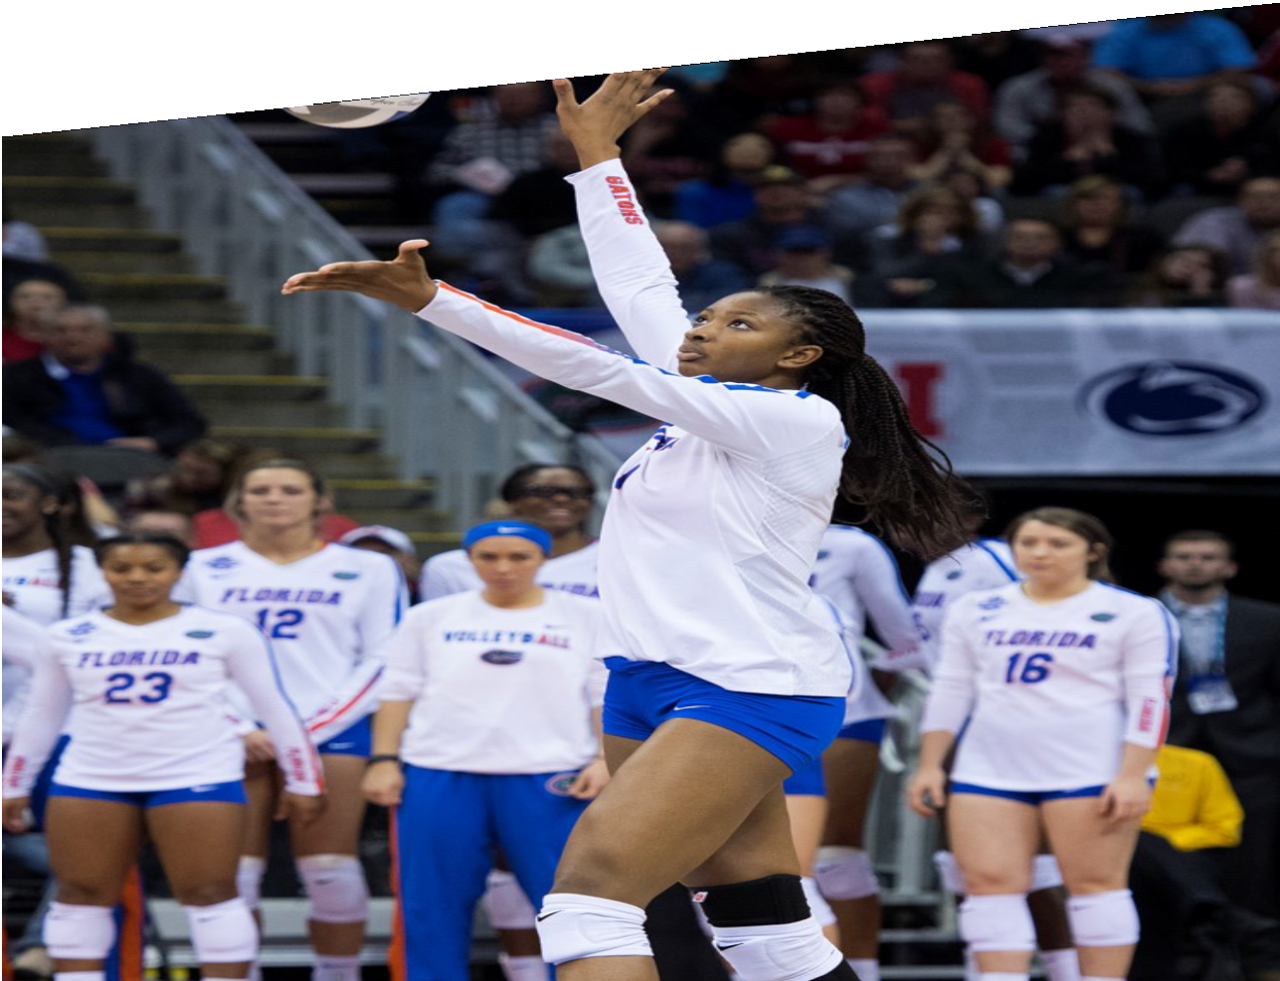

AGENDA
What is the NCAA?
What is the NCAA Eligibility Center?
High School Timeline. Registration.
Initial-Eligibility Standards.
Division I. Division II.
Sports Participation. Resources.

Slide 3
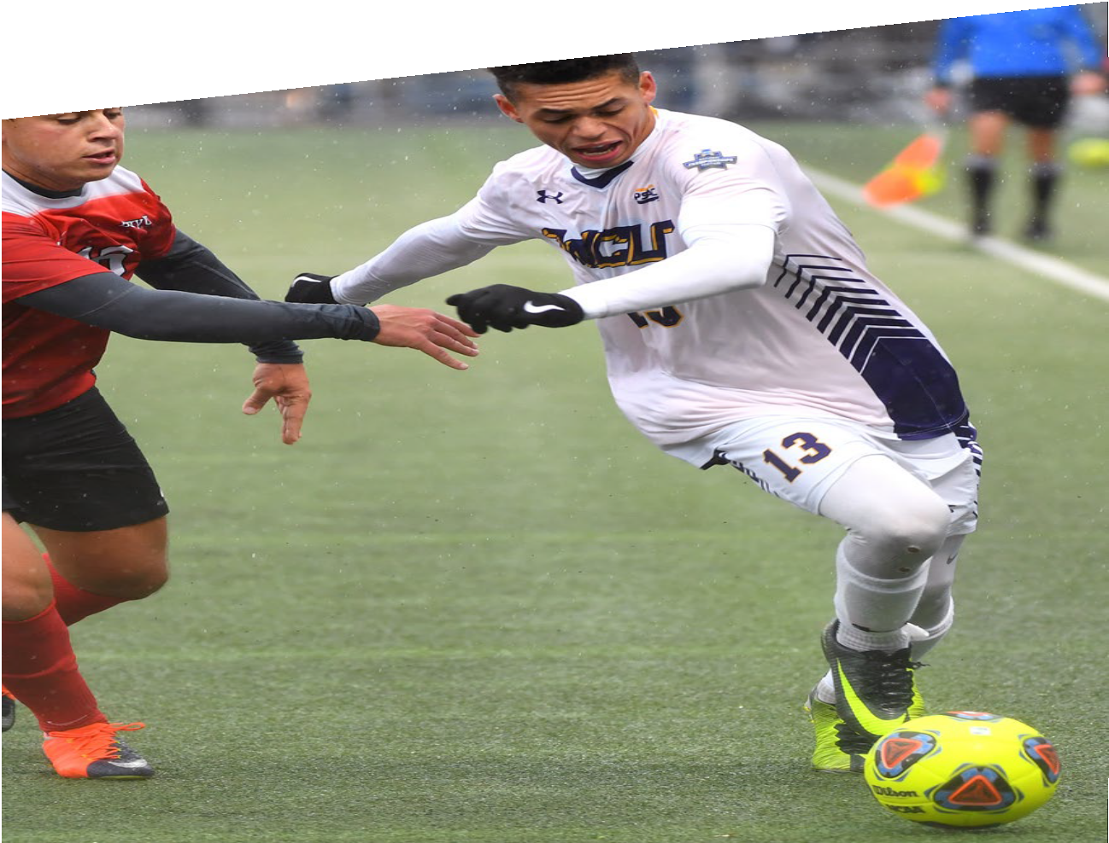

WHAT IS
THE NCAA?
NCAA members and the national office are dedicated to the lifelong success of college athletes. They are committed to providing a pathway to opportunity by prioritizing academics,
well-being and fairness for student-athletes.

Slide 4
WHAT IS THE NCAA ELIGIBILITY CENTER?
The NCAA Eligibility Center evaluates and certifies prospective student- athletes for collegiate competition at Divisions I and II schools.
We focus on:
Academic preparedness.
Sports participation.
High school courses.
Customer service.
Students who want to compete at NCAA Division I or Division II schools need to meet NCAA Eligibility Center:
Academic initial-eligibility requirements. Amateurism requirements.

Slide 5
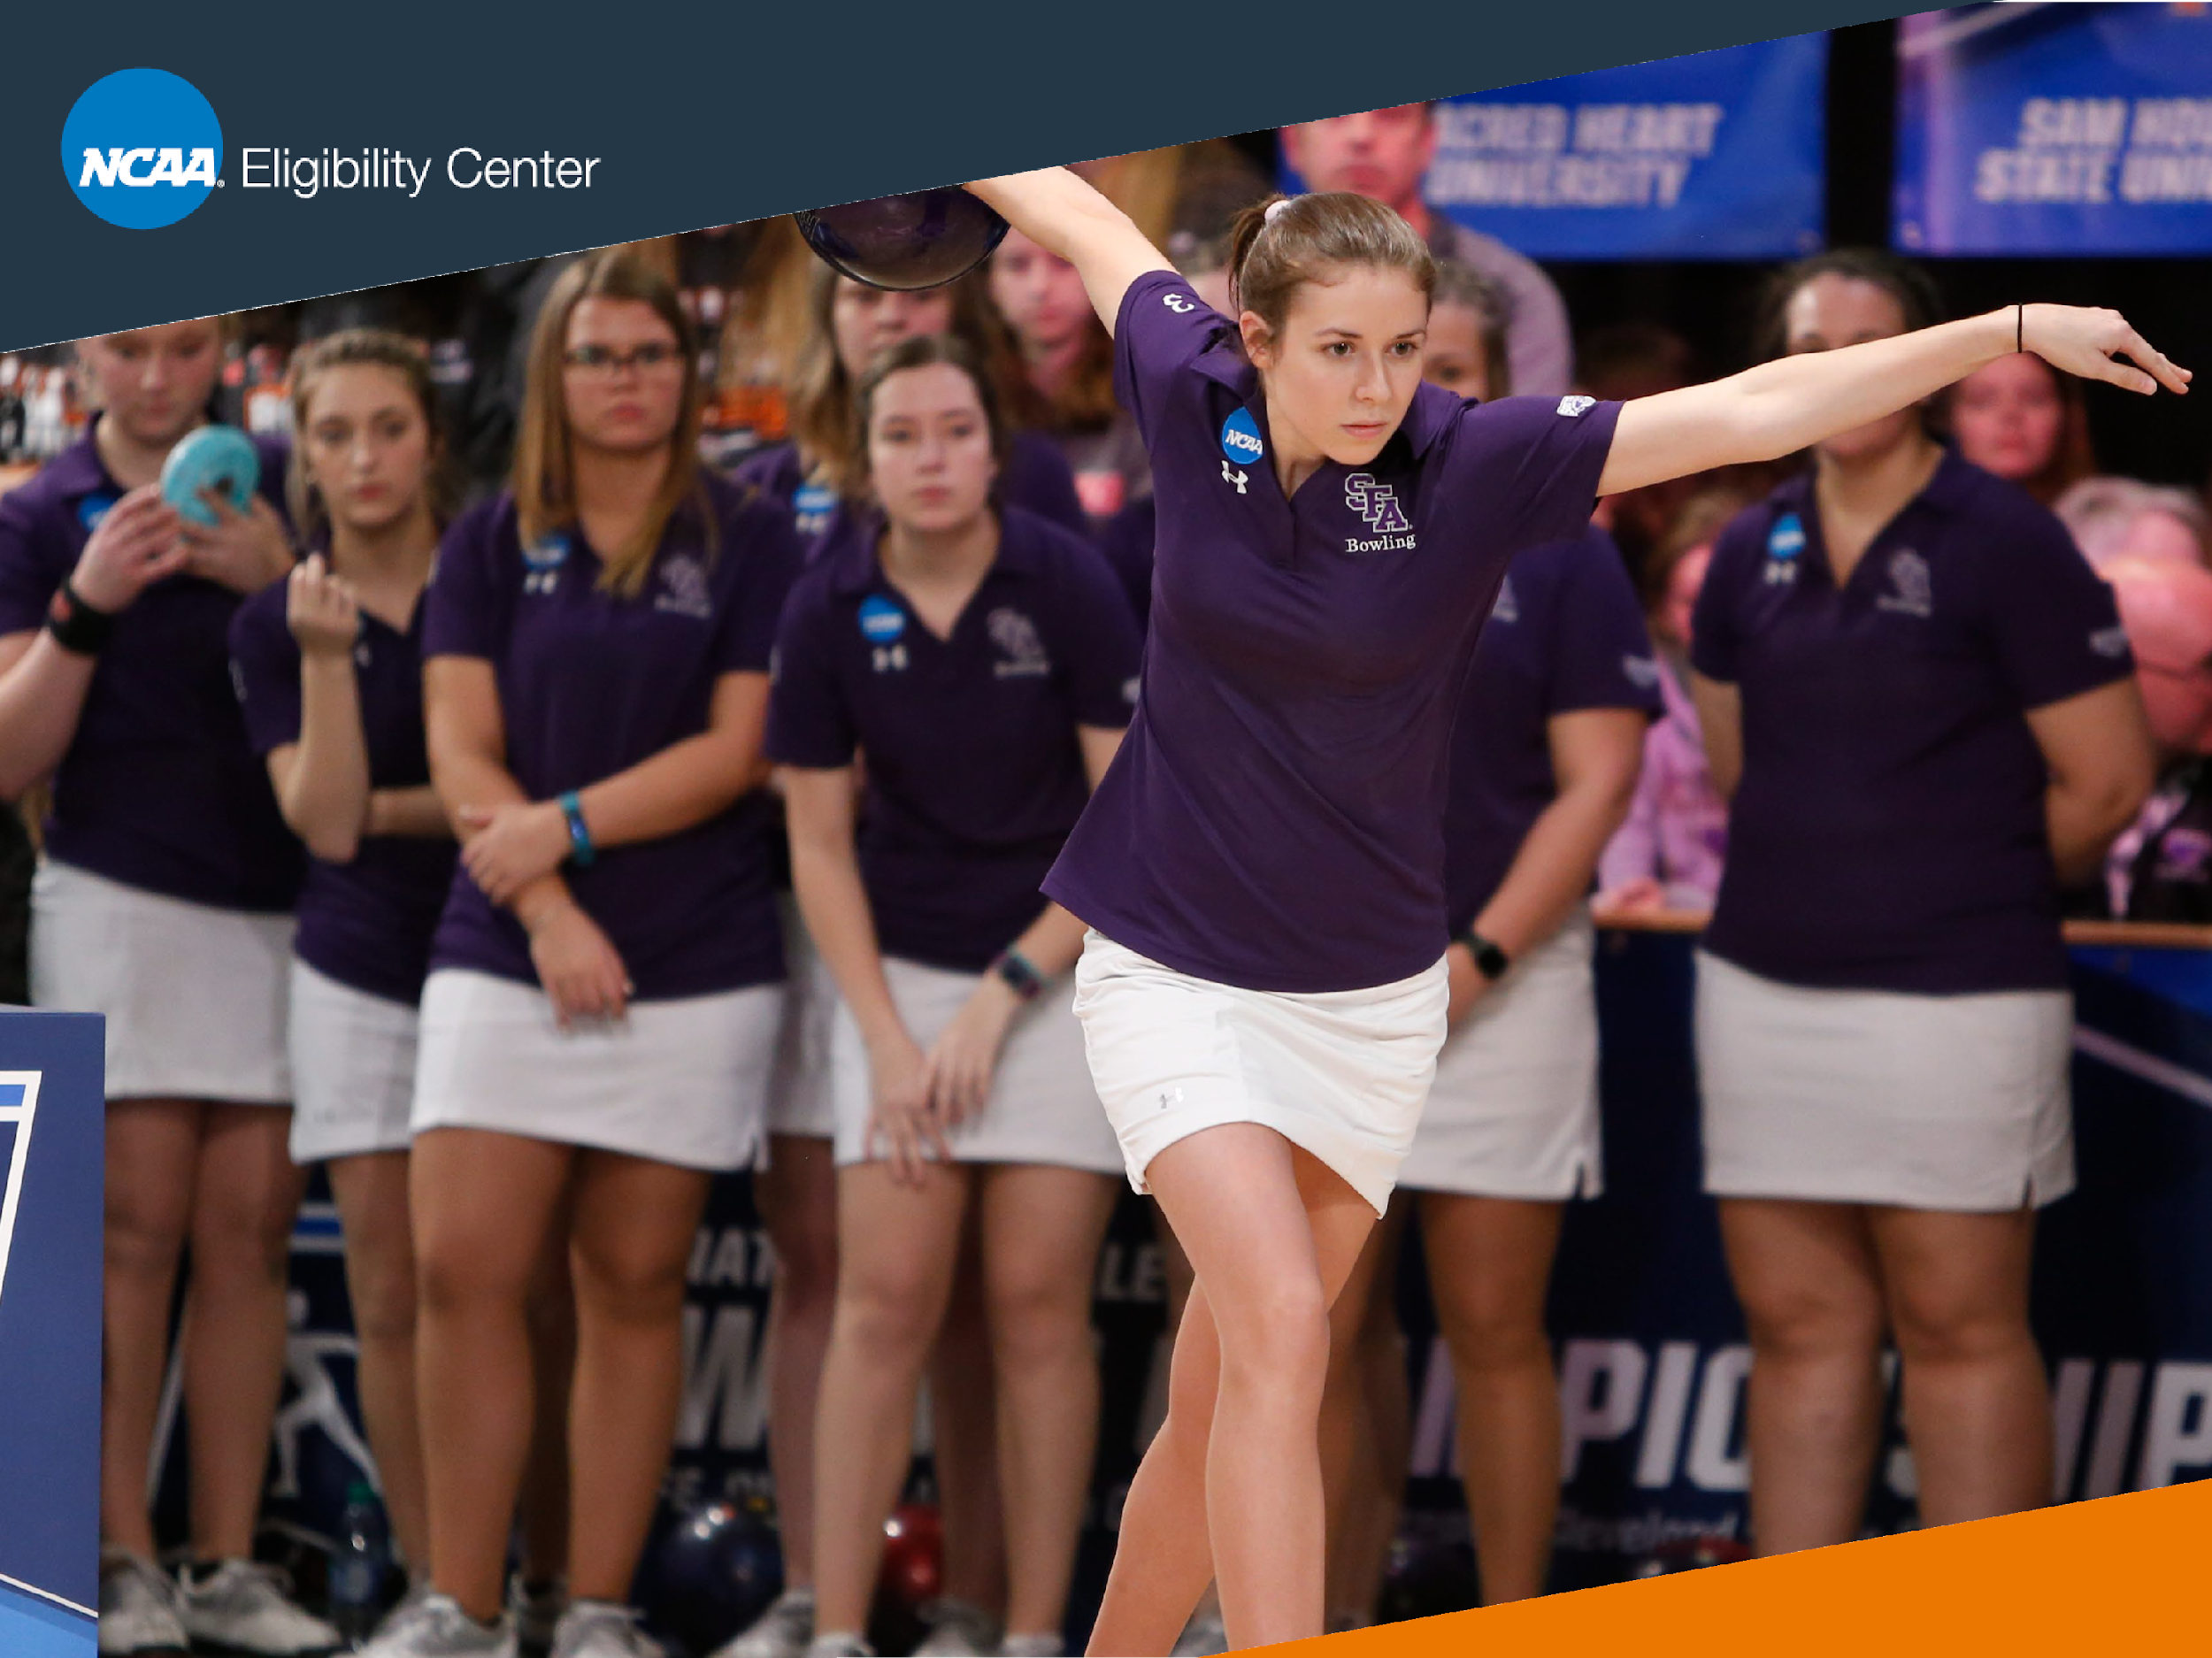
HIGH SCHOOL TIMELINE
College-bound student-athletes should follow these suggestions to prepare for Division I and Division II initial-eligibility requirements.

Slide 6
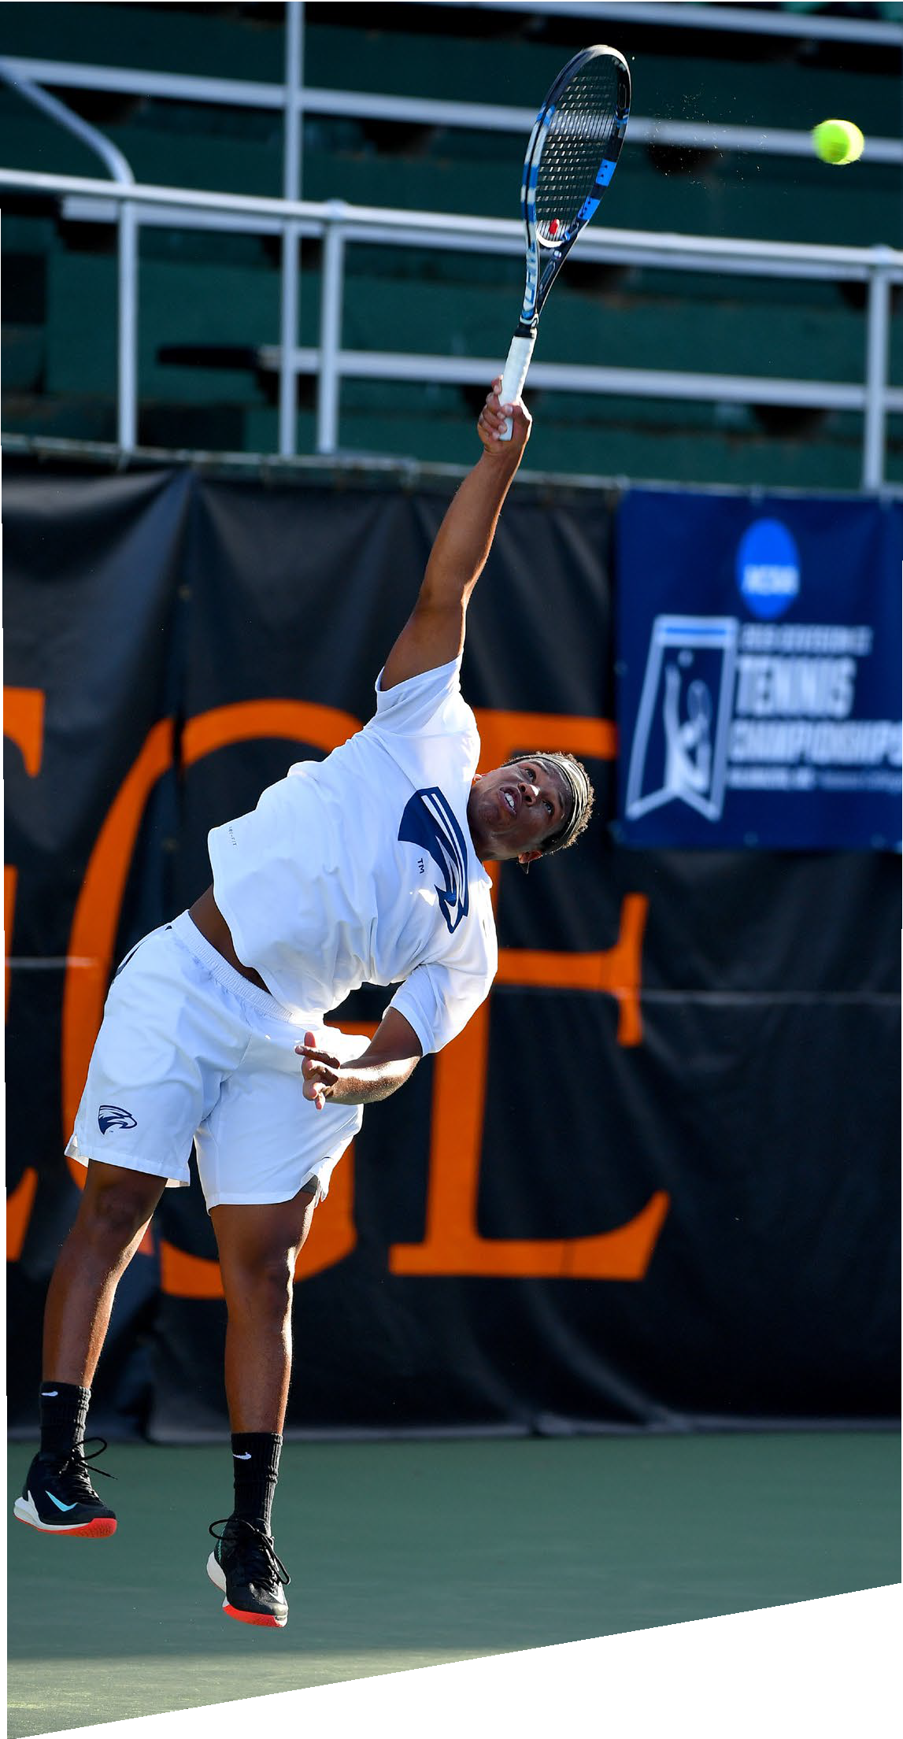

GRADE PLAN 9:
Start planning now! Take the right courses and earn the best grades possible.
Find your high school’s list of NCAA- approved core courses at eligibilitycenter.org/courselist.
Sign up for a free Profile Page at eligibilitycenter.org for information on NCAA requirements.

Slide 7
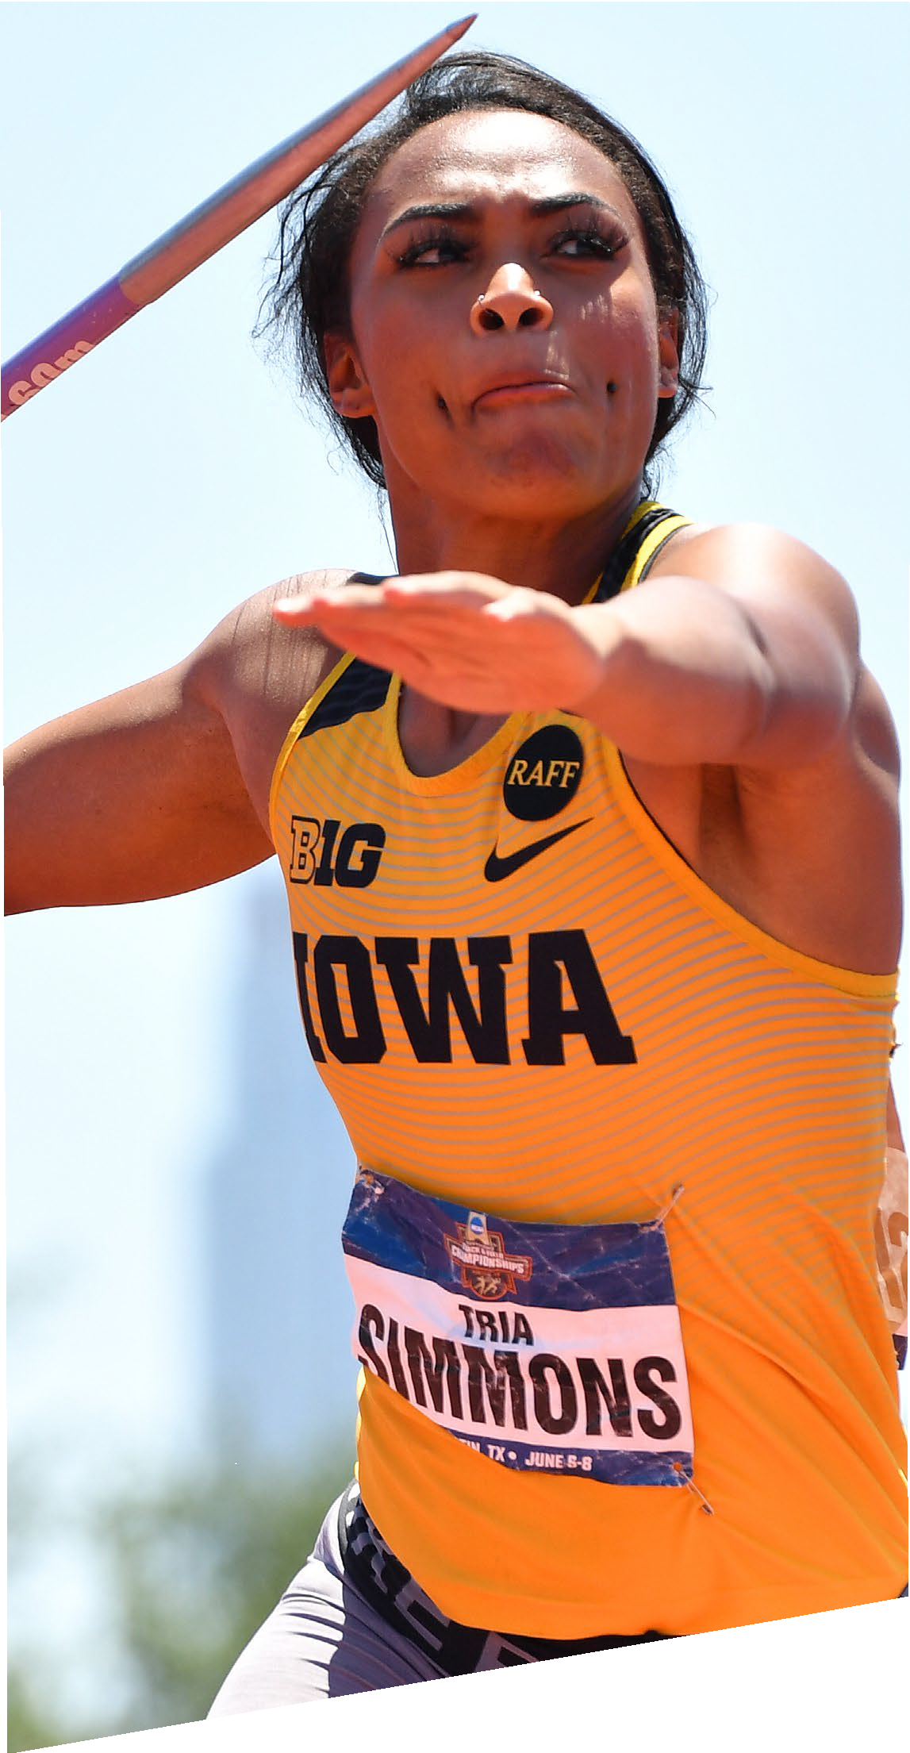
GRADE 10:
REGISTER
If you fall behind academically, ask your counselor for help finding approved courses you can take.
Register for a Profile Page or Certification Account with the NCAA Eligibility Center at eligibilitycenter.org.
Monitor your Eligibility Center account for next steps.
At the end of the year, ask your counselor at each high school or program you attended to upload your official transcript to your NCAA Eligibility Center account.

Slide 8

GRADE 11:
REGISTER
Check with your counselor to make sure you are on track to complete the required number of NCAA-approved courses and graduate on time with your class.
Take the ACT or SAT and submit your scores to the NCAA Eligibility Center using code 9999.
Ensure your sports participation information is correct in your Eligibility Center account.
At the end of the year, ask your counselor at each high school or program you attended to upload your official transcript to your NCAA Eligibility Center account.

Slide 9
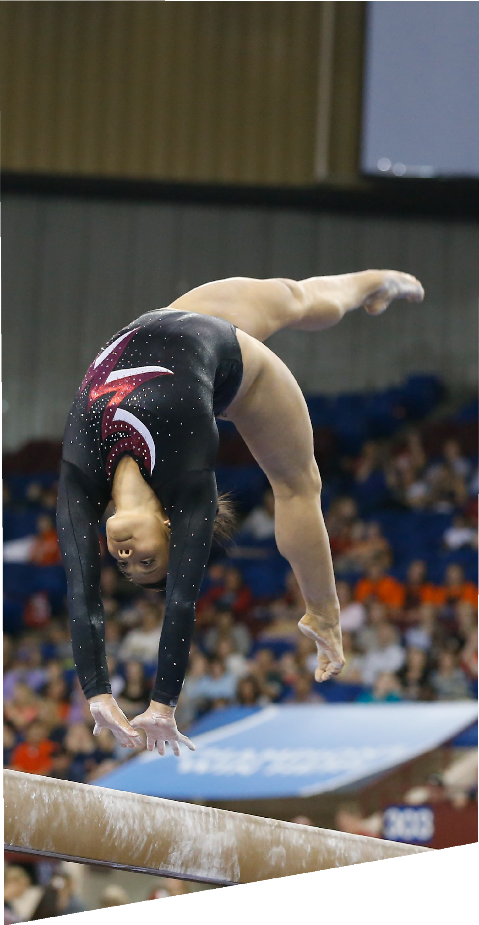

GRADE 12:
GRADUATE
Complete your final NCAA-approved core courses as you prepare for graduation.
Take the ACT or SAT again, if necessary, and submit your scores to the NCAA Eligibility Center using code 9999.
Request your final amateurism certification in your Certification Account at eligibilitycenter.org.
April 1 (fall enrollees).
Oct. 1 (winter/spring enrollees).
After you graduate, ask your counselor to upload your final official transcript with proof of graduation to your NCAA Eligibility Center account.
Reminder: Only students on an NCAA Division I or II school’s institutional request list will receive a certification.

Slide 10


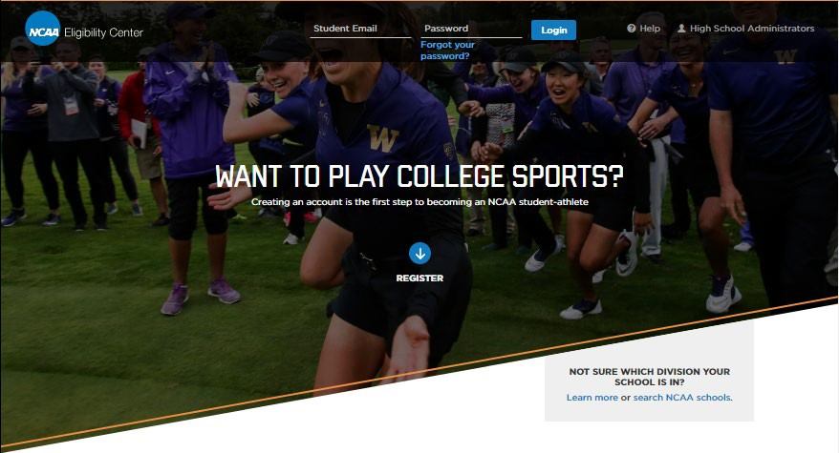
ELIGIBILITY CENTER
REGISTRATION
You can register for a Certification Account or Profile Page at eligibilitycenter.org to begin the process to becoming an NCAA student-athlete.

Slide 11

TWO ACCOUNT TYPES
Certification Account
Division I or Division II students. Domestic fee $90.
International fee $150.
Account information, school and sports history.
Required for signing a National Letter of Intent (NLI) with a Division I or Division II NCAA school.
Required to go on an official visit to a Division I or Division II NCAA school.
Profile Page Undecided students. Division III students. No fee.
Account information and school history.
Can transition to a Certification Account at any time.
Will not receive an academic or amateurism certification.

Slide 12

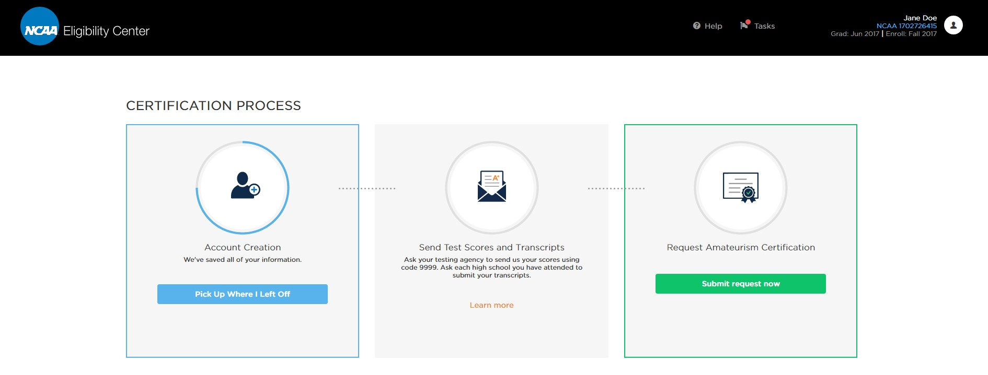
Review your Dashboard for open tasks.
Update your graduation or enrollment dates if needed.
Review your combined SAT or ACT sum test scores.
View your transcripts on file.
Edit your account, schools or sports information.

Slide 13
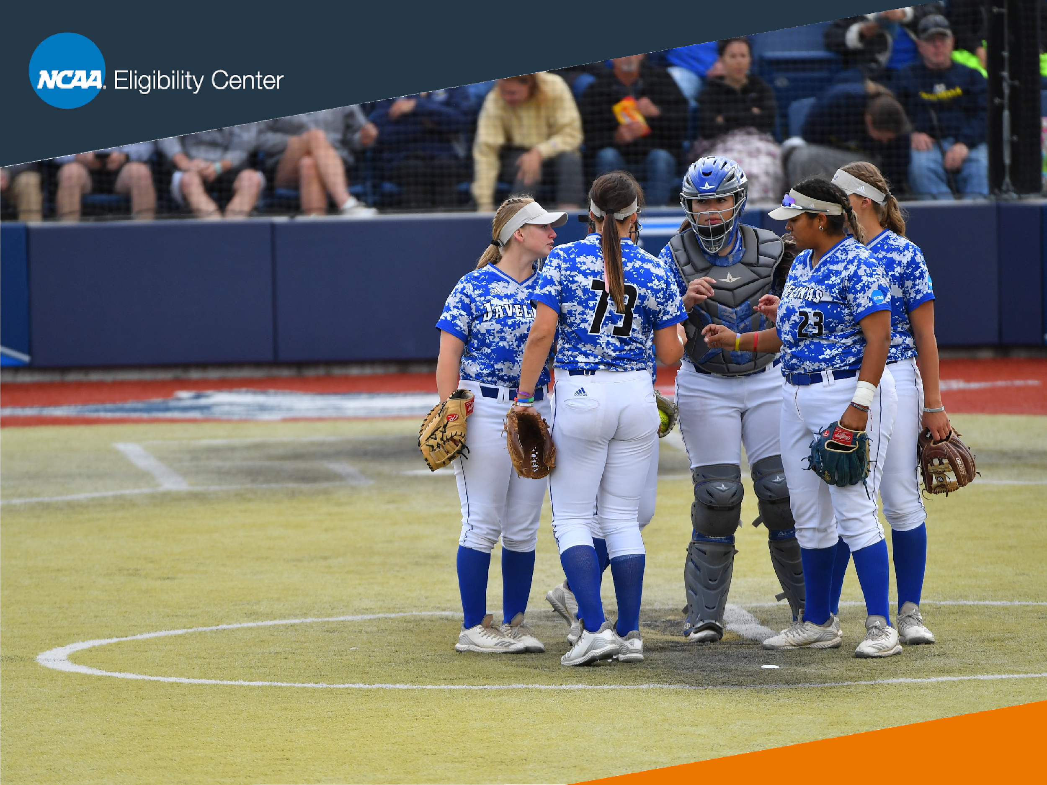
INITIAL-ELIGIBILITY STANDARDS
The NCAA’s commitment to academics ensures students are better equipped to succeed in college and prepare for lifelong success.
Students need to meet the following academic requirements to be eligible to compete in college sports.

Slide 14
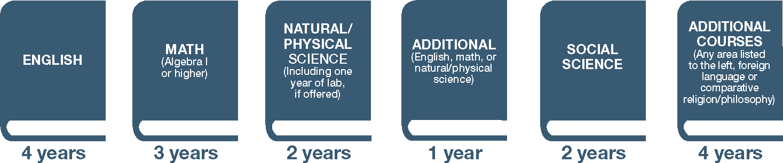
WHAT IS A CORE COURSE?
NCAA core courses include courses that:
Qualify for high school graduation in English, mathematics (Algebra 1 or higher), natural or physical science, social science, foreign language or comparative religion or philosophy.
Are considered four-year college preparatory.
Are taught at or above the high school’s regular academic level. Are taught by a qualified instructor.

Slide 15
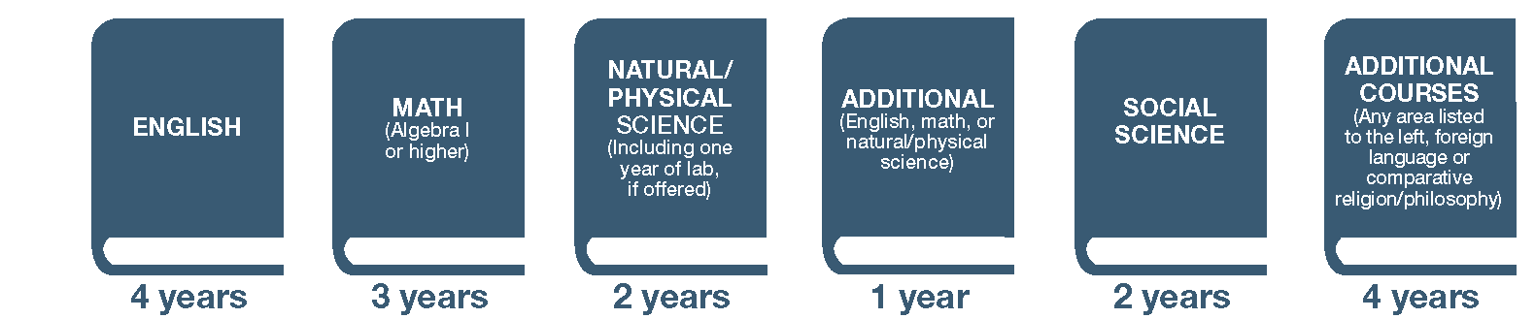
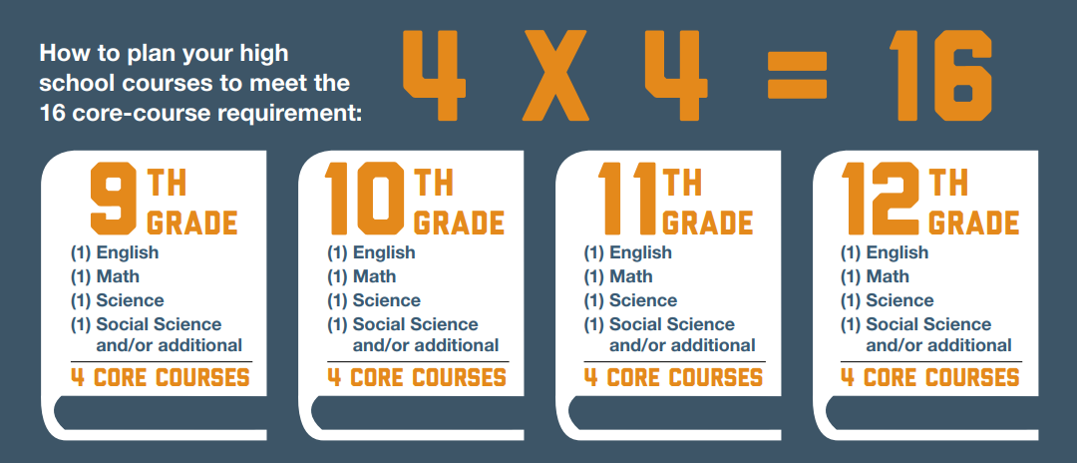
DIVISION I: CORE COURSES
The following must be completed by the start of your seventh semester in high school:
10 NCAA-approved core courses from your school’s list in the appropriate subjects.
Seven of the 10 courses must be in English, math or science.

Slide 16
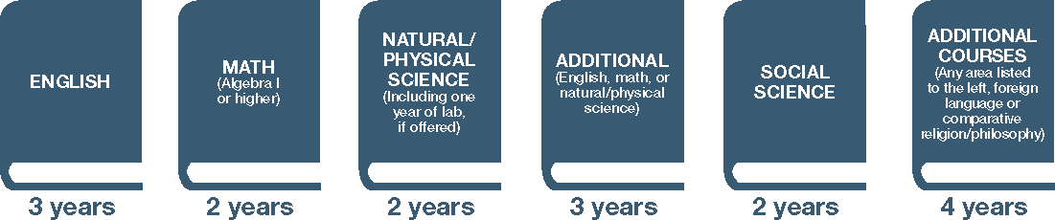
DIVISION II: CORE COURSES
Core-course requirements must be met in the time limitation:
You can use all core courses completed starting your ninth-grade year until you enroll full time at a Division II college or university.

Slide 17
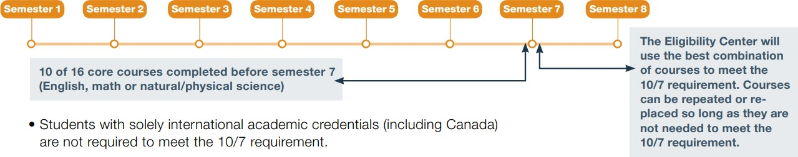

DIVISION I:
CORE-COURSE TIME LIMITATION
When you enter ninth grade, you have four years
(eight semesters) to complete your core-course requirement.
If you do not complete high school on time, your core courses taken after high school will not count toward NCAA requirements.
On time: If your high school graduation takes place June 1, you must graduate June 1. If you do not graduate June 1, you have not completed your requirements on time.

Slide 18

Find your school’s list of NCAA- approved core courses by going to eligibilitycenter.org/courselist.

Slide 19
THINGS TO CONSIDER BEFORE
TAKING NONTRADITIONAL COURSES
The courses must meet NCAA core course requirements and be on an NCAA-approved core-course list.
The courses must have ongoing and regular teacher-initiated interaction for the purposes of teaching, evaluating and providing assistance throughout the duration of the course.
This may include synchronous or asynchronous instructive interaction, including emails, video conferencing, online chats, phone calls and feedback on assessments.
The courses must have a defined time period for completion.
This means the nontraditional program must identify the fastest and slowest paths to successfully complete a course (i.e., maximum and minimum time frame for completion).

Slide 20
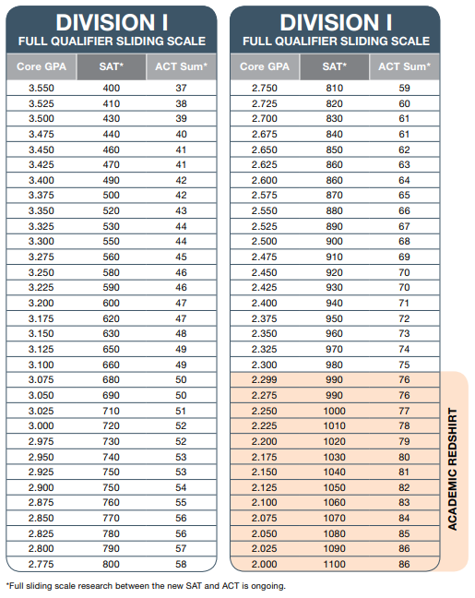
DIVISION I: INITIAL-ELIGIBILITY
ACADEMIC REQUIREMENTS
To play Division I sports, you need to meet the following academic requirements:
Graduate high school on time.
Complete 16 NCAA-approved core courses in the correct subjects.
Earn a minimum core-course GPA of 2.300.
Earn a combined SAT or ACT sum score that matches your core-course GPA on the Division I sliding scale.

Slide 21
DIVISION I: QUALIFIER
DI qualifiers are eligible to practice, compete and receive athletics aid their first year of college enrollment.
Qualifiers meet the standards of:
16 core courses in the correct subjects. 10/7 core-course progression.
Minimum core-course GPA of 2.300.
Combined SAT or ACT sum score that matches their core-course GPA on the sliding scale.

Slide 22
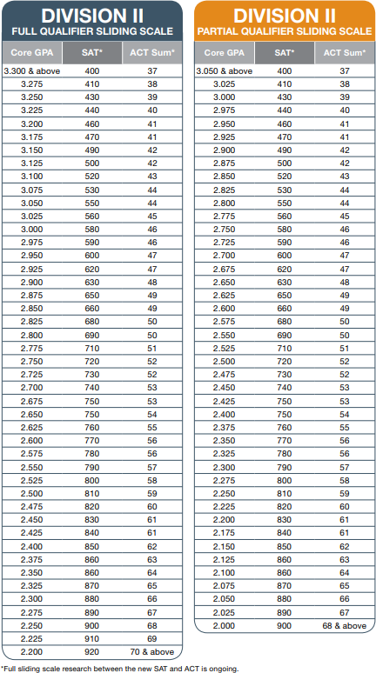
DIVISION II: INITIAL-ELIGIBILITY
ACADEMIC REQUIREMENTS
To play Division II sports you need to meet the following academic requirements:
Complete 16 NCAA-approved core courses with the correct subject distribution.
Graduate high school on time.
Earn a minimum core-course GPA of 2.200.
Earn a combined SAT or ACT sum score that matches your core-course GPA on the
full-qualifier scale.

Slide 23
DIVISION II:
EARLY ACADEMIC QUALIFIER
If you meet specific criteria listed below after six semesters, you may be deemed an early academic qualifier for Division II and may practice, compete and receive an athletics scholarship.
To be an early academic qualifier, you will need:
Minimum sum score of 68 on the ACT or a minimum SAT combined score (math and critical reading) of 820 on SAT tests taken before March 2016 or 900 if SAT taken March 2016.
A core-course GPA of 2.5 or higher in a minimum of 14 core courses in the following areas:
3 years of English.
3 years of math.
2 years of natural or physical science.
6 additional core courses in any area.

Slide 24
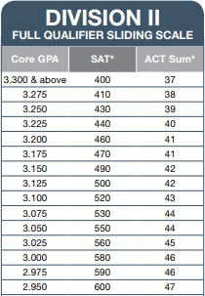
DIVISION II: QUALIFIER
DII qualifiers are eligible to practice, compete and receive athletics aid their first year of college enrollment.
Qualifiers meet the standards of:
16 core courses in the correct subjects.
Minimum core-course GPA of 2.200.
Combined SAT or ACT sum score that matches
their core-course GPA on the full-qualifier sliding scale.

Slide 25
DIVISION III: INITIAL-ELIGIBILITY
REQUIREMENTS
Each Division III college or university determines its own eligibility for:
Admission. Financial aid.
Practice and competition.
The NCAA Eligibility Center does not perform certifications for Division III college-bound student-athletes.
Division III student-athletes may register for a free Profile Page, but it is not required.

Slide 26
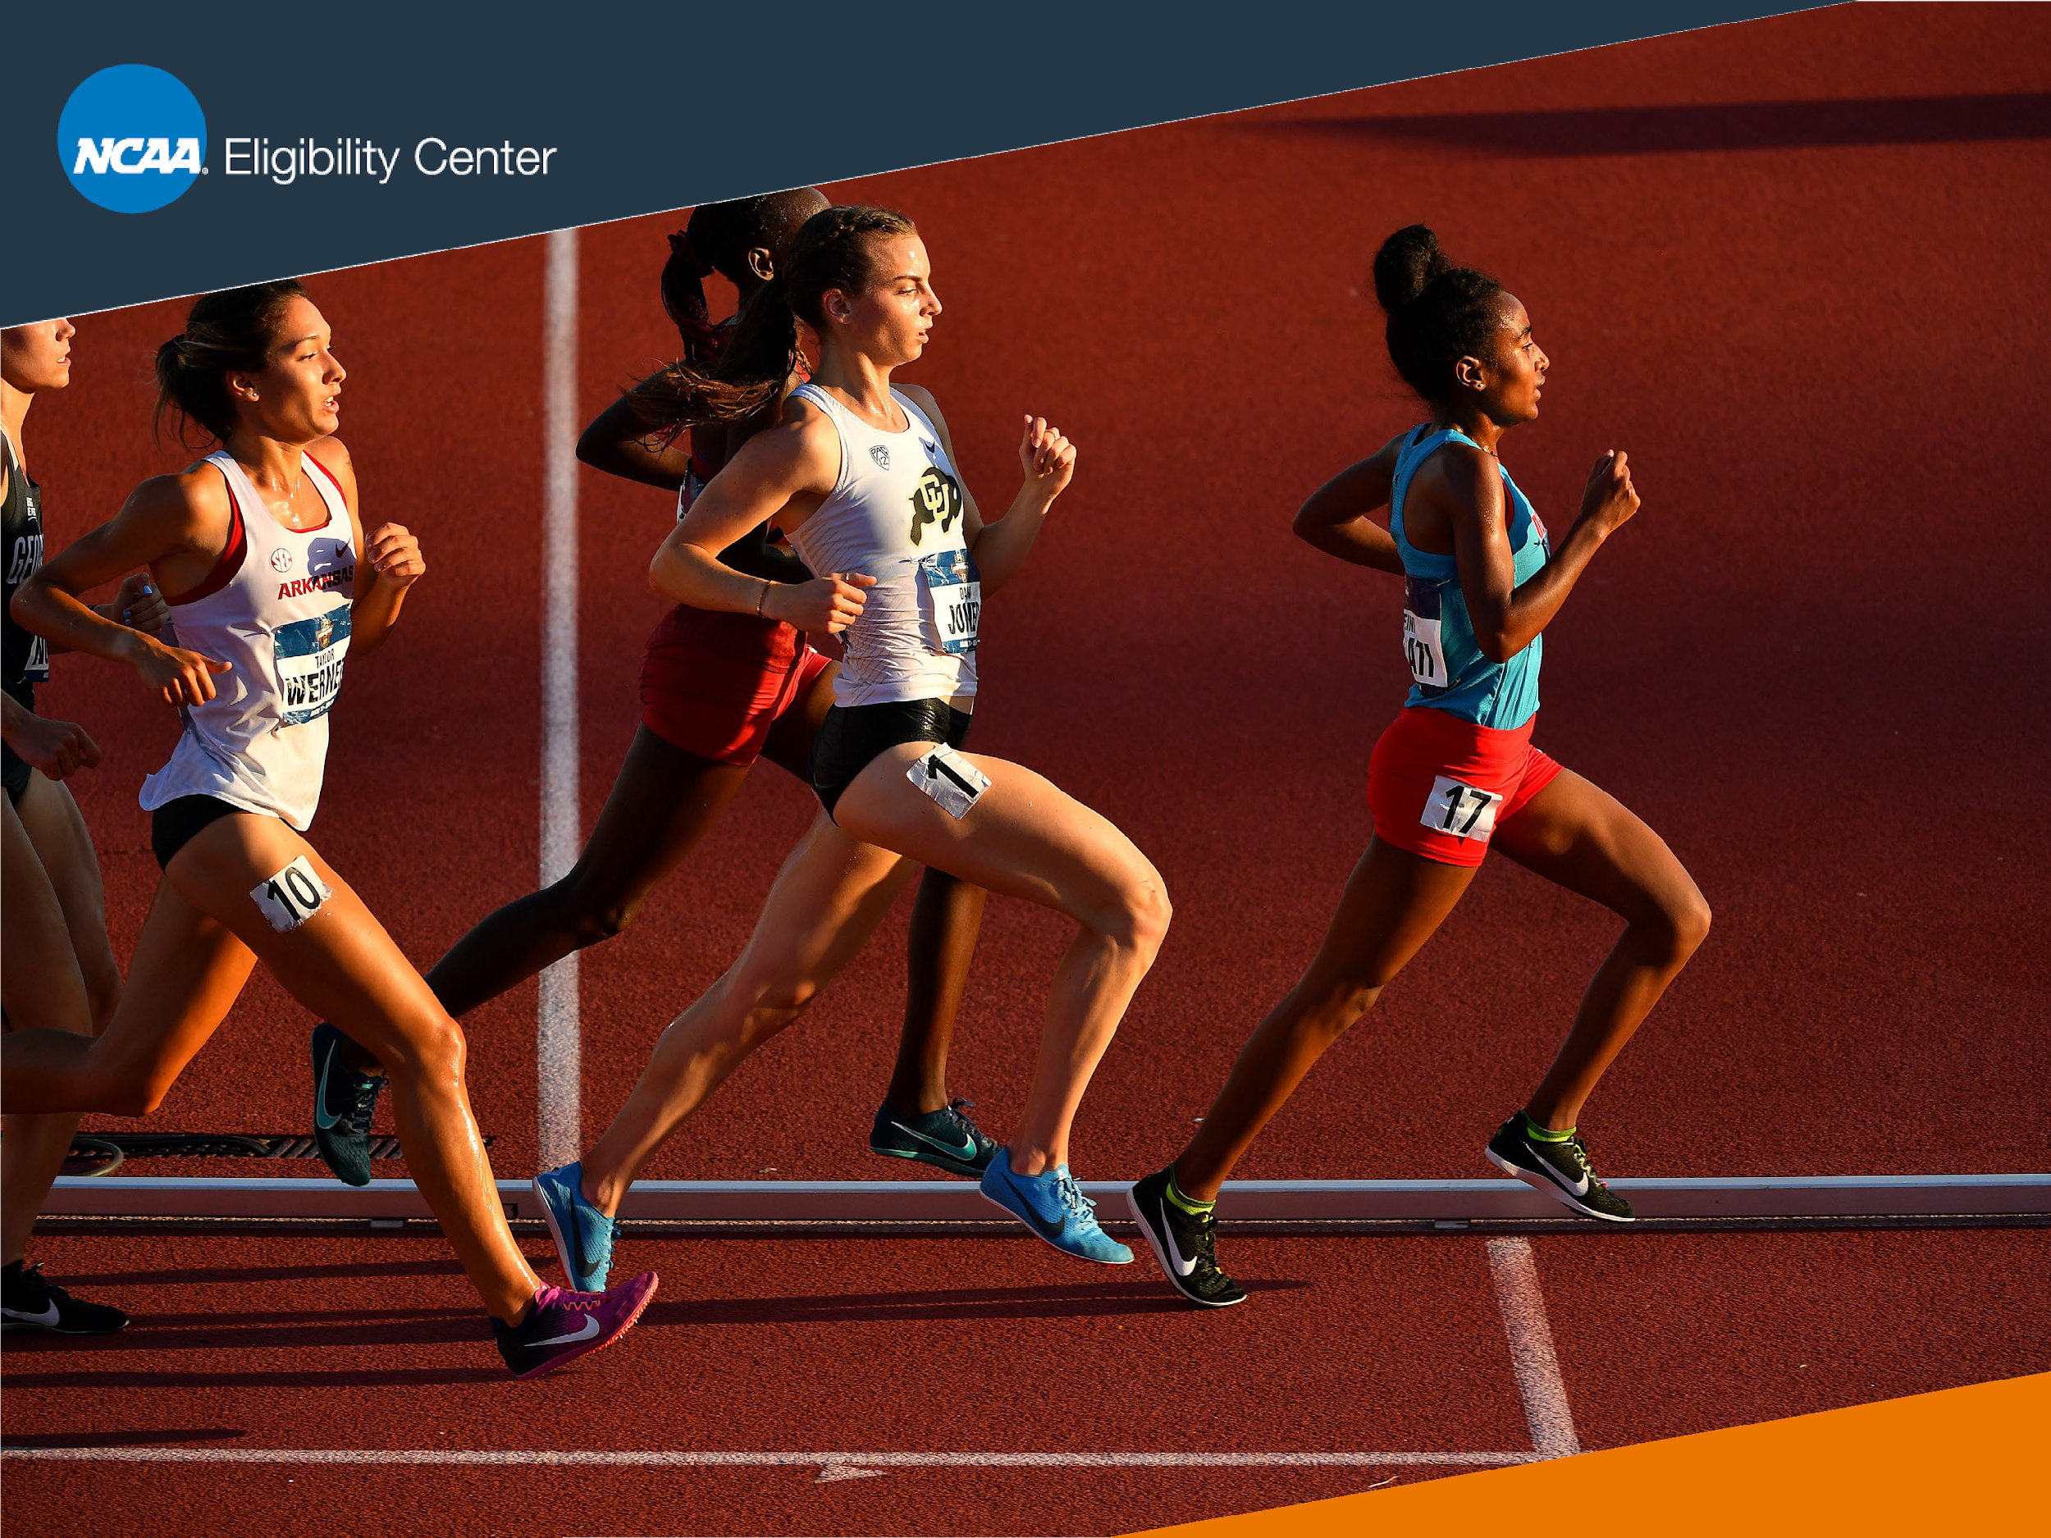
SPORTS PARTICIPATION
The NCAA Eligibility Center also evaluates amateurism. Students must follow these tips to stay eligible to compete in college sports before full-time enrollment.

Slide 27
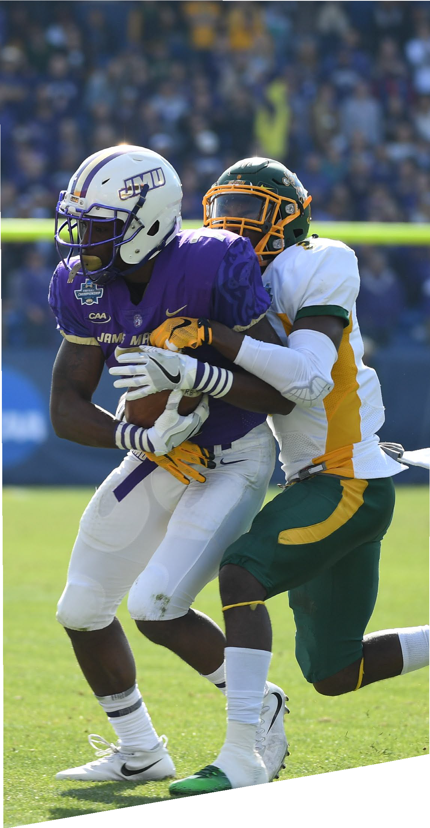
SPORTS
When you register with the NCAA Eligibility Center for a Certification Account, you must:
Select the sport(s) you would like to play in college.
Complete questions about sports participation.
Update your information frequently if you play for multiple teams or attend events outside the traditional high school setting.
Request final amateurism certification before you enroll full time at a Division I or Division II school.
Note: Over 94 percent of students don’t require additional amateurism questions from the NCAA Eligibility Center after they request final amateurism.

Slide 28
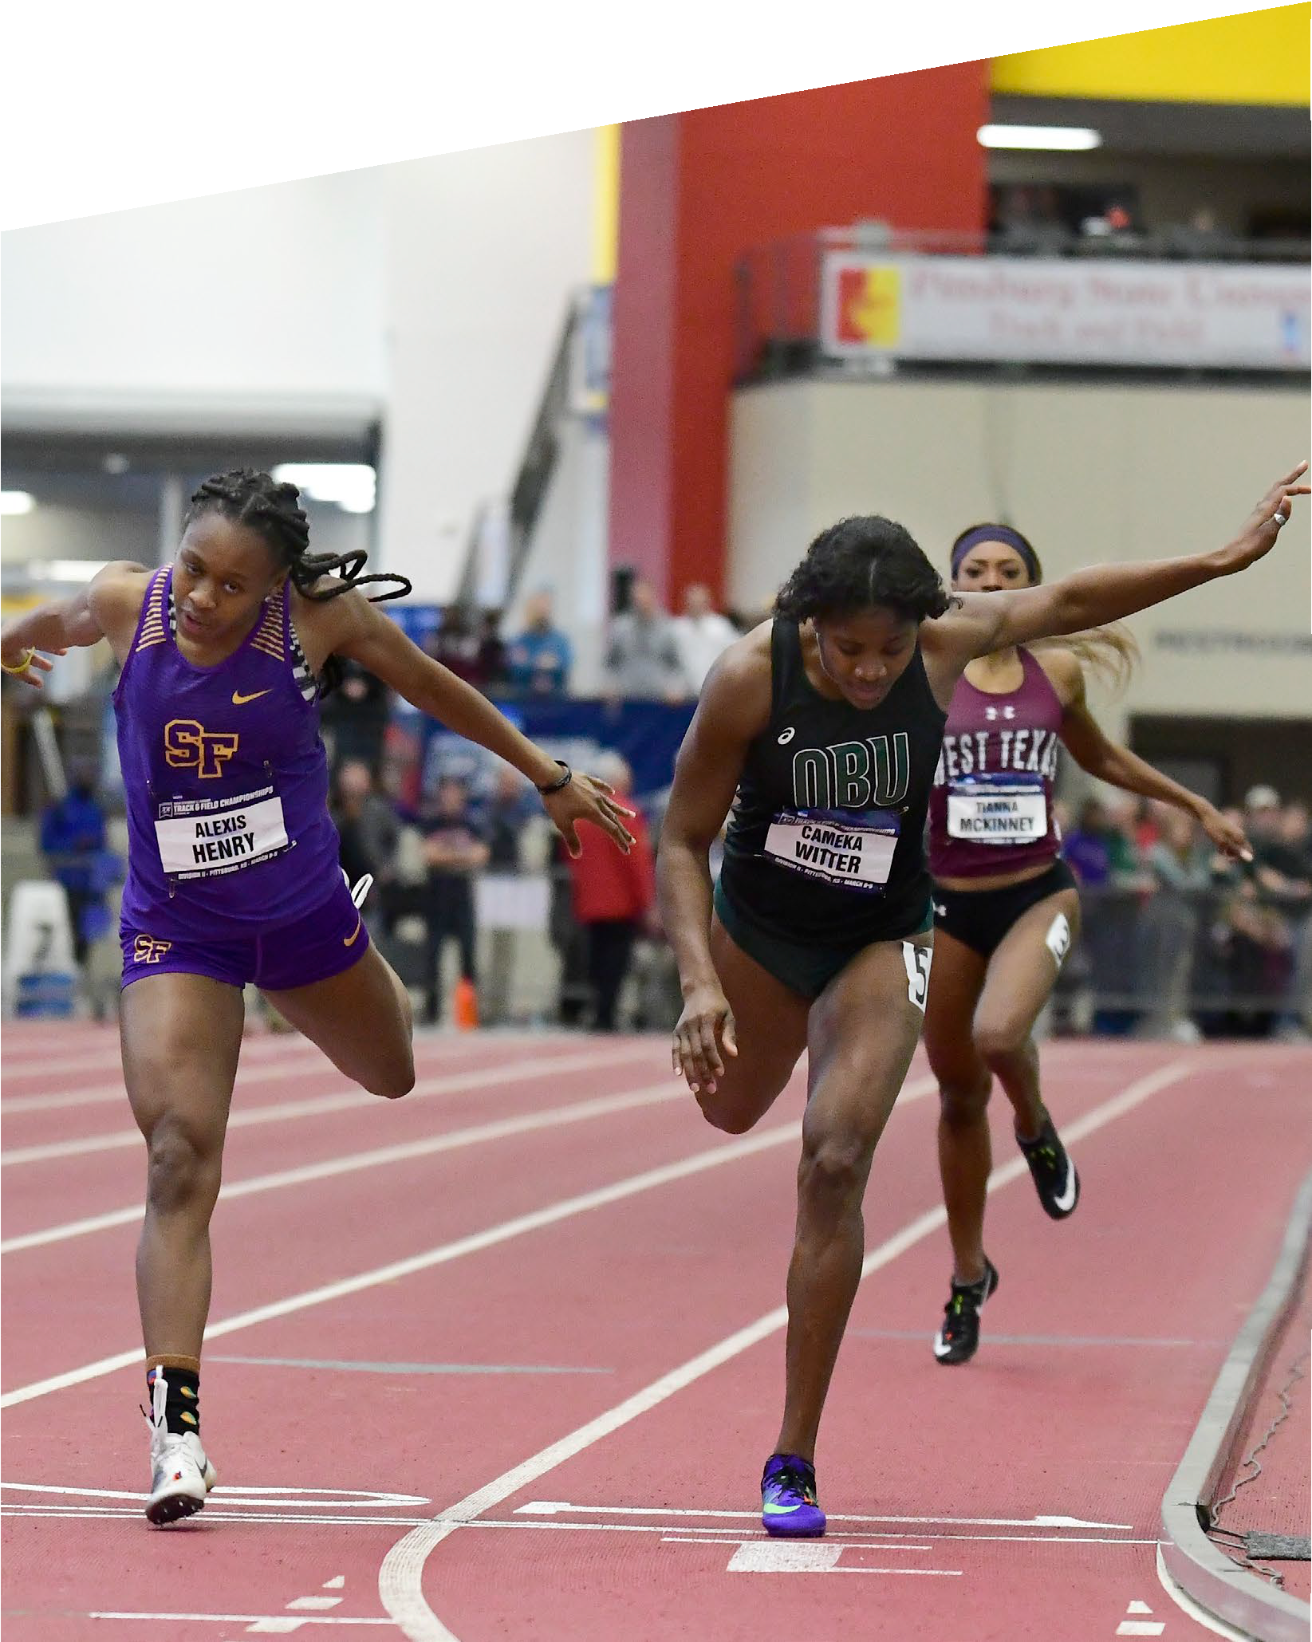

PROACTIVE
REMINDERS
Share your NCAA ID
number with schools recruiting you.
Don’t forget to apply to the
school of your choosing
and confirm you’ve been accepted.
Learn about the NLI here. Request final amateurism
certification before you
enroll full time in college.
Ask your counselor to send
your final transcript(s) with proof of graduation.

Slide 29
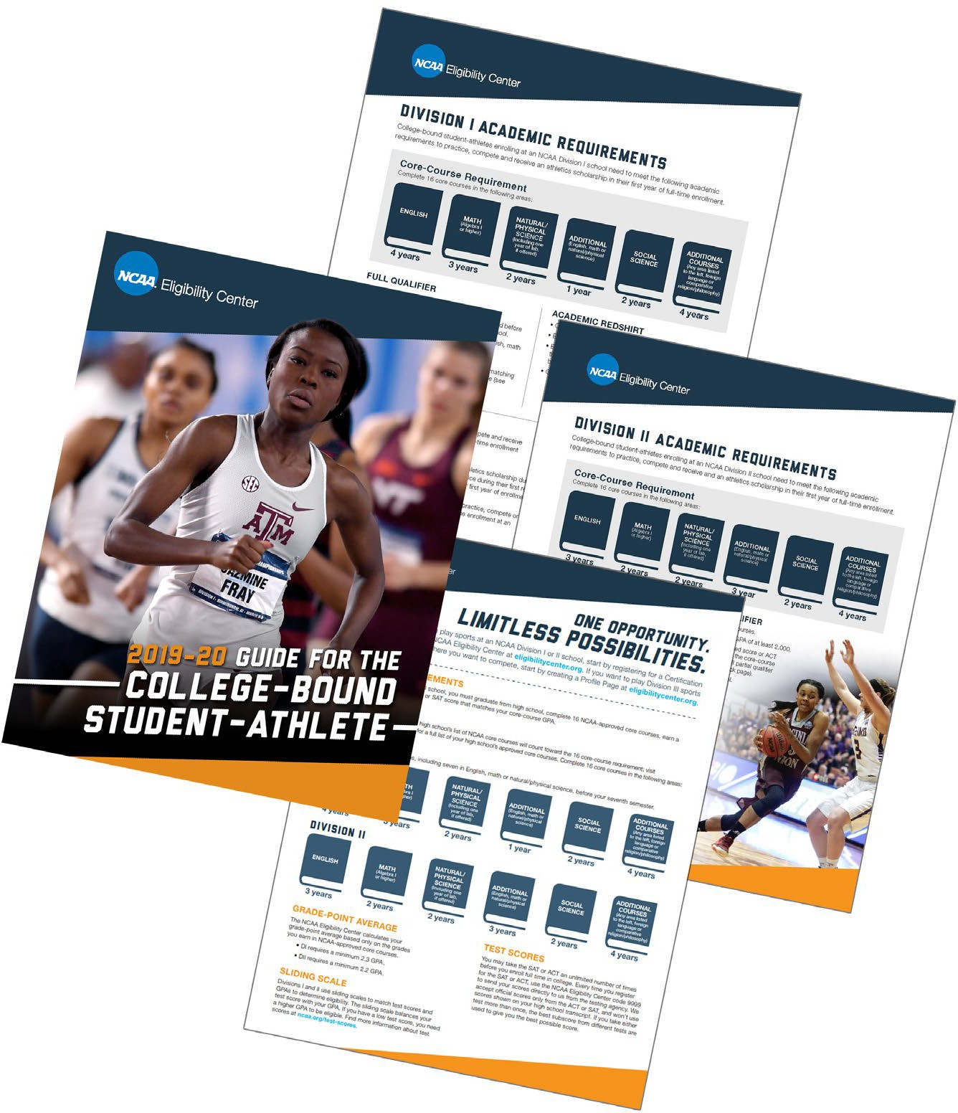

RESOURCES
Visit our websites: ncaa.org/playcollegesports. eligibilitycenter.org.
Get updates—follow us Twitter @NCAAEC.
Instagram @playcollegesports.
Visit nationalletter.org to learn about the NLI.
Download our resources: Initial-Eligibility Brochure.
Guide for the College-Bound Student-Athlete.
DI Initial-Eligibility Quick Reference Sheet.
DII Initial-Eligibility Quick Reference Sheet.

Slide 30

THANK YOU
Contact the NCAA Eligibility Center: 317-917-6222.
877-262-1492.
9:00 a.m. to 5:00 p.m. Eastern Standard time, Monday through Friday.

Slide 31
THANK YOU
NCAA Eligibility
Recruiting Calendar
Parent Webinar Link
COVID-19 Update
Registration Center

